Slide 1
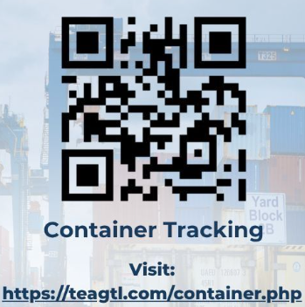
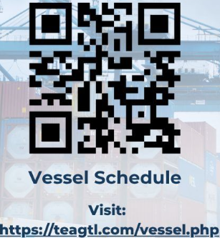

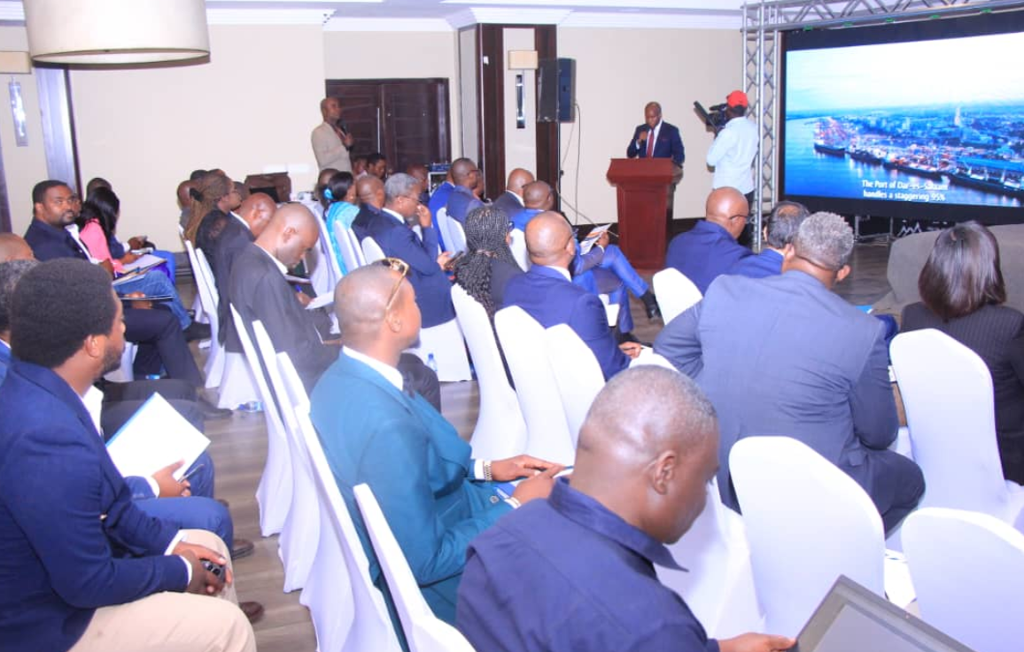
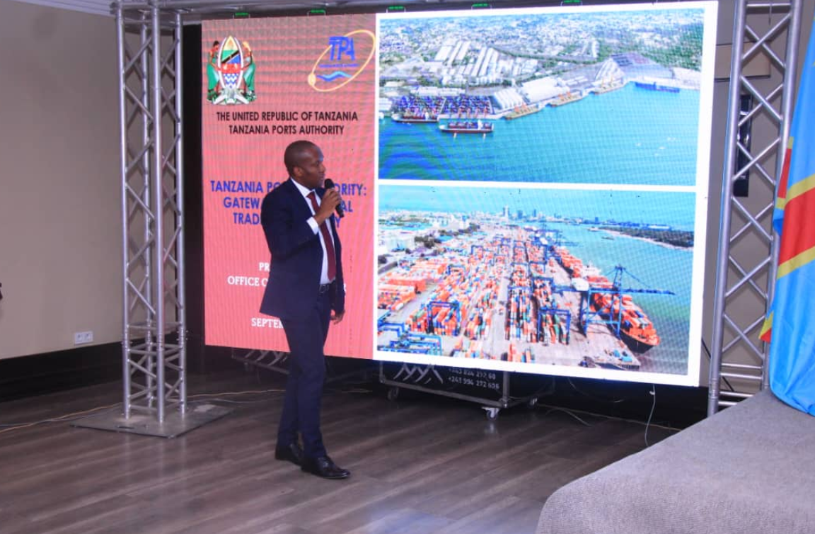
October 2025 Monthly Newsletter
Enhancement to Digital Container Tracking functionality
We are happy to share that our Container Tracking digital functionality has now been enhanced with the inclusion of container movement to Kwala ICD, providing greater visibility into your supply chains
These tools are accessible at www.teagtl.com
You can also use the below QR codes to access both these functionalities and track your cargo or get updated vessel schedules at the click of a button.
Customer Outreach
As part of our customer outreach initiative, to connect with the EXIM community in East Africa, we – jointly with TPA – visited customers in the Democratic Republic of Cargo.
At an exclusive customer event, recent productivity improvements and service enhancements at Dar es Salaam were highlighted, showcasing the strategic advantages of Dar es Salaam as the Gateway to East and Central Africa.
Volumes
71,944 TEUs
Vessels Handled
26 Vessels

