Slide 1
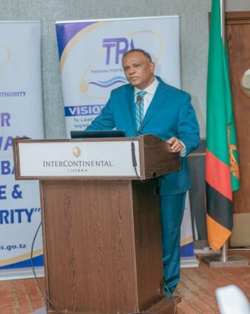
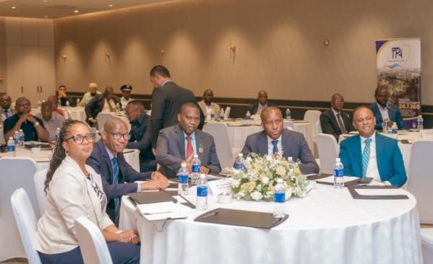
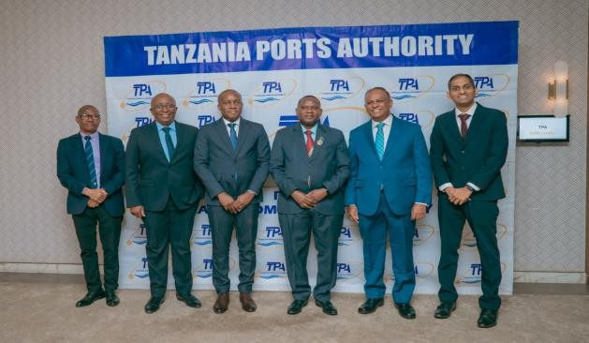
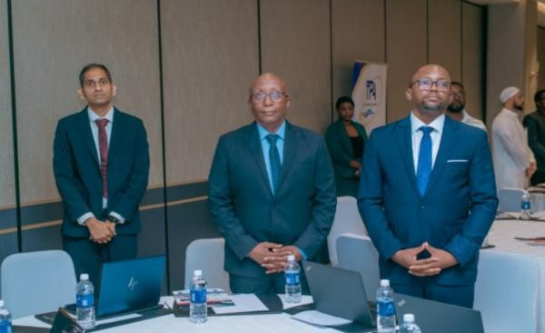
Monthly Newsletter
November 2025
Volumes
71,75c TEUs
Vessels Handled 23 Vessels
Prioritising Operational Stability
In the face of a challenging situation, our entire team has put in a stellar effort to minimise impact on vessel handling and cargo movement.
We continue to focus on employee safety and operational stability, to ensure that your supply chains continue running smoothly, with minimal disruptions.
We appreciate your support and understanding.
Customer Outreach
In continuation of our Customer Outreach program, we visited customers in Lusaka, Zambia, in collaboration with TPA.
Additionally, we hosted a customer event, where esteemed invitees were given a comprehensive overview of the infrastructure at Dar es Salaam port and recent customer-centric improvements, such as the Container Tracking and Vessel Schedule tools – cementing our position as the Gateway to East and Central Africa.

