Slide 1
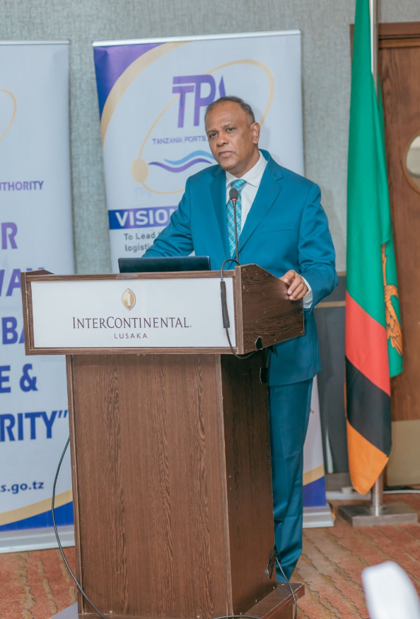

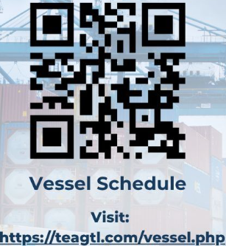
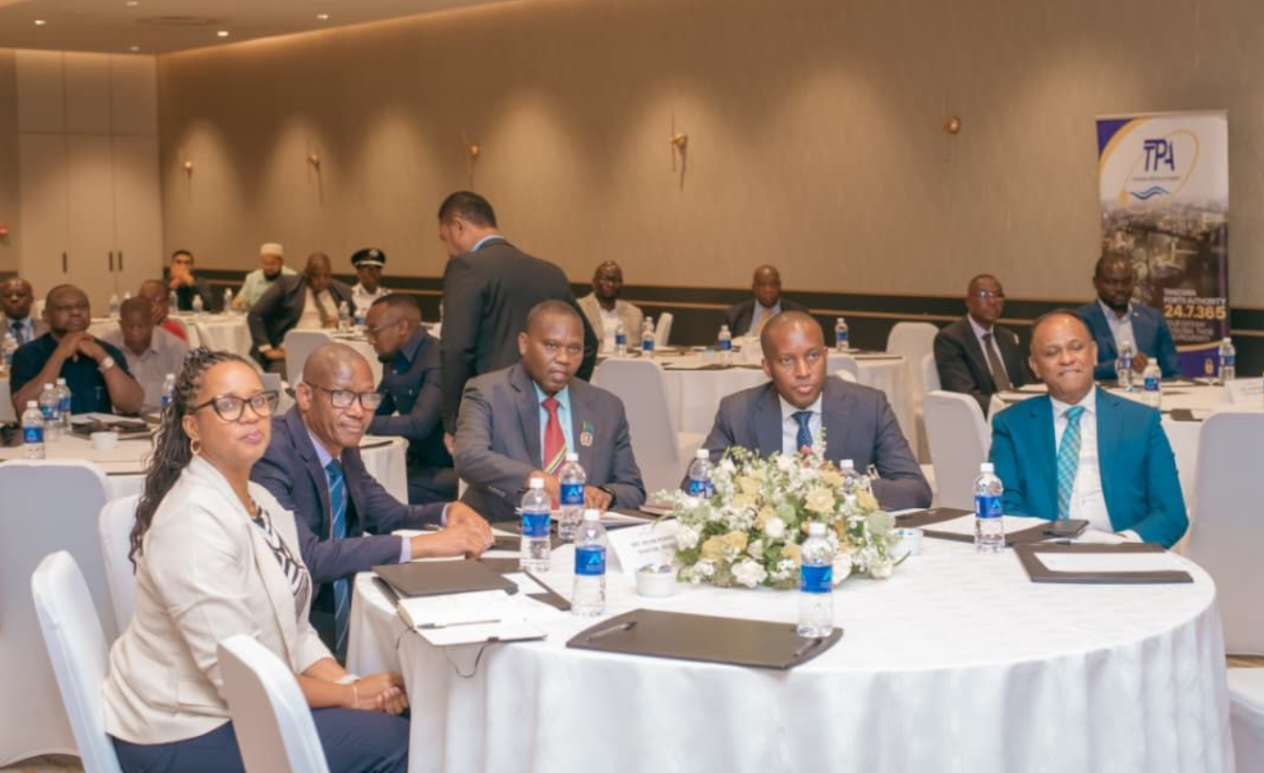

January 2026 Monthly Newsletter
Organisational Resilience in 2025
TEAGTL finished 2025 on a strong note, registering our highest ever throughput of 864,633 TEUs, a YoY increase of 5.5%.
Vessel calls also witnessed an impressive YoY increase of 9.5% (281 vs 257 in 2024).
Overall, 2025 was characterised by robust operational performance, enhancement of our suite of digital tools, and customer-centric improvements, to elevate our service and efficiency levels.
2026: Promising Times Ahead
In 2026, we have planned several initiatives to augment our digital offerings, improve customer experience, and partner your regional and global supply chains, details of which will be shared as we progress.
We would like to wish you and your loved ones a Happy New Year and thank you for your continued support in TEAGTL’s growth story.
Volumes
69,551 TEUs
Vessels Handled
25 Vessels

