Slide 1
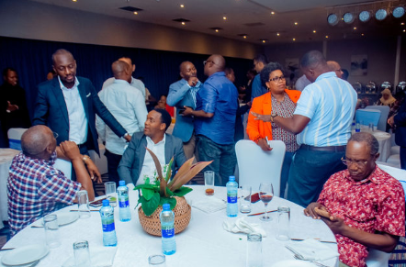
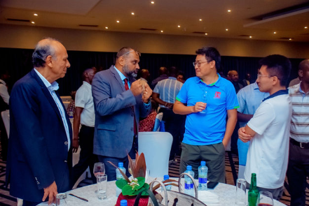
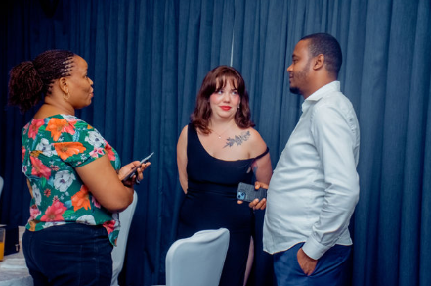
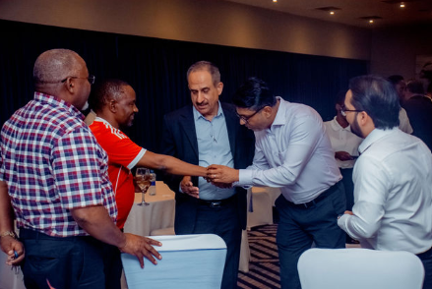
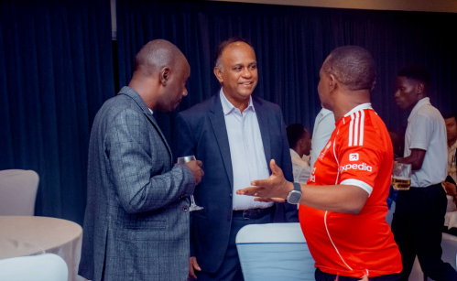
February 2026 Monthly Newsletter
Strong Start to 2026
TEAGTL began 2026 on a strong note, registering strong volume performance of 73,762 TEUs in January 2026 - representing a YoY increase of 13% and a MoM increase of 6%.
During the same period, we handled 22 vessels.
As we roll out ambitious projects, covering Infrastructure, Digital Transformation, and Rail Connectivity, we are confident of sustaining this momentum in 2026.
Customer Engagement
As part of our ongoing customer outreach initiatives, we hosted an exclusive dinner to honour our esteemed customers.
At the well-attended event, customers were given an overview on TEAGTL’s endeavours to enhance Customer Centricity, Digital Tools, and Efficiency.
Customers also took the floor to share their feedback, which was mostly laudatory in nature and duly noted for further improvements.
Volumes
73,762 TEUs
Vessels Handled
22 Vessels

