Slide 1

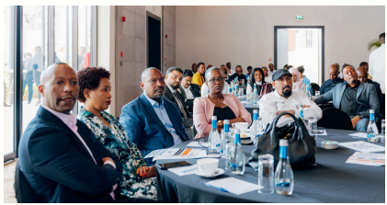
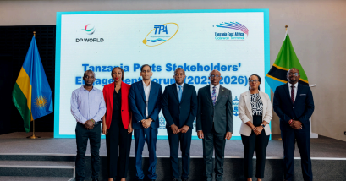
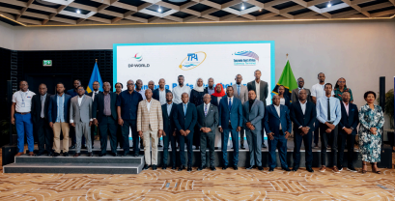
December 2025 Monthly Newsletter
Resuming Stable Operations
We showcased our organisational and operational resilience during the trying circumstances, the impact of which spilled over in November as well.
With immaculate planning and impeccable execution, we were successful in clearing the backlog in a short span o time.
Our focus continues to be on employee safety and ensuring efficient cargo flows.
We appreciate your continued support and understanding.
Customer Outreach
As part of our extensive Customer Outreach program in key markets, we – in in collaboration with TPA – interacted with customers in Rwanda.
During an exclusive event, customers were proffered an overview of our state-of-the-art infrastructure and recent customer-centric improvements, such as digital tools:
Container Tracking
Vessel Schedule tools
Volumes
64,670 TEUs
Vessels Handled
20 Vessels

