Slide 1
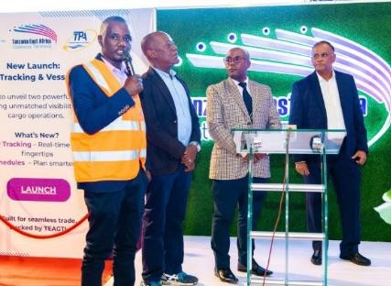
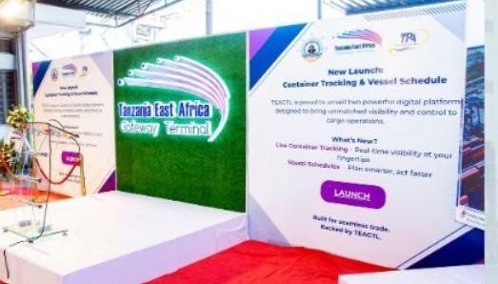

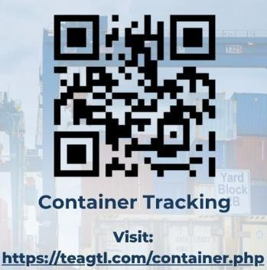
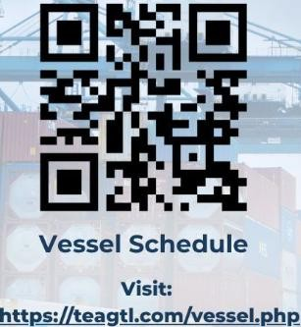
Monthly Newsletter
August 2025
Launch of Digital Container Tracking
and Vessel Schedule sharing
We are happy to share that we have launched two powerful digital functionalities - Container Tracking and Vessel Schedule Sharing - marking a major step forward in the port’s digital transformation and customer experience journey.
Both these digital tools are available on our website and are intended to resolve one of the most persistent challenges faced by port users
- lack of supply chain visibility.
These tools are accessible at www.teagtl.com
Volumes
74,331 TEUs
Vessels Handled 23 Vessels
These functionalities provide a self- service interface, reducing administrative work, saving valuable time and effort
Overview of functionalities:
Container Tracking: real-time location and status of containers, with data such as Vessel name/ Delivery location / Dwell time / Terminal in/out timestamps
Vessel Schedules: information on Vessel arrival & departure schedules/ Assigned berthing windows / Gate opening & cut-off timelines / Expected sailing times

